Slide 1
Aristotle (384-322)
‘The Philosopher’

Slide 2
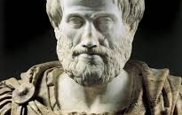

Slide 3
‘The Philosopher’
Epistemological categories
Logic Logic
Physics Theoretical philosophy
Metaphysics Theoretical philosophy
Ethics Practical philosophy
Politics Practical philosophy
Poetry Poetic philosophy

Slide 4
What do we want from life?
‘’What is the highest of all goods? Well as far as the name goes there is pretty general agreement. ‘It is happiness’ say both ordinary and cultured people’’

Slide 5
How do we achieve this?
Rejection that self interest best served by seeking pleasure or power or injustice
We need to know who we are
We need to develop our virtues to live the best possible life
The best possible life is determined by the ultimate ‘Good’

Slide 6
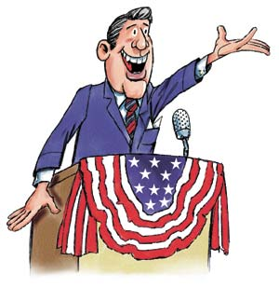
Power and injustice?
Rejection – Self sufficiency > Sophistry
Winning the respect of other cannot be the key to a good life

Slide 7
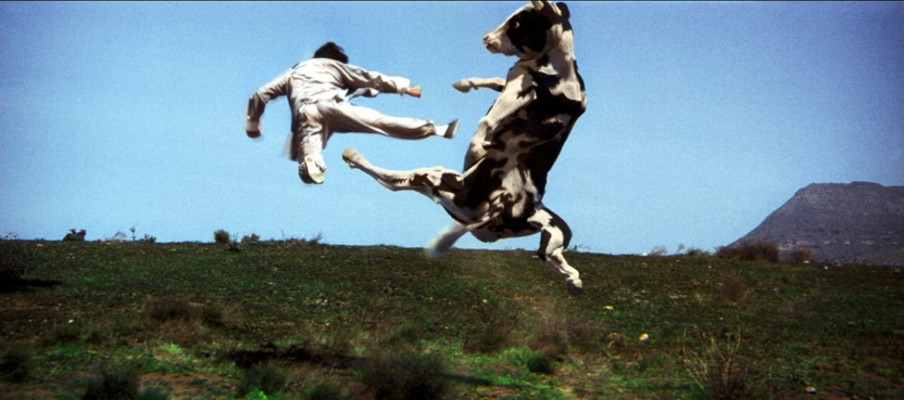
Hedonism?
Rejection – Function > Fulfilment
We are not merely pleasure seeking beasts like cows

Slide 8
So…….Knowledge of self
‘’It is evident that the statesman ought to have some acquaintance with psychology, just as a doctor who intends to treat an eye must have knowledge of the body as a whole’’

Slide 9
Teleological division of the soul..
Theoretical reasoning
Philosophy; Maths; NS; Theology
Practical reasoning
Deliberation; U/st; J/ment; Cleverness
Desire + Emotion
Courage; Temperance; Patience; Modesty; Friendliness; Magnamity; Rght Indignation
Nutrition + growth (vegetative)

Slide 10
How to become virtuous…

