Slide 1

The Wall Street Crash
29th October 1929

Slide 2
The Roaring 20s
(Rep) Government policy of laissez faire.
US industry had been boosted by the war.
Protectionism - import duties raised (1922).
Mass production: cars, radios, refrigerators.
Hire Purchase - people could buy on credit. There is massive consumer spending.
Confidence!!

Slide 3
The Roaring 20s
Farmers DID NOT prosper
new machines produced more which lowered prices.
The African-American population DID NOT prosper
farmers laid them off, given low paid jobs and lived in slums.
Recent immigrants DID NOT prosper
they were given low paid jobs and lived in slums.
Workers in old industries DID NOT prosper
they were given low paid jobs and lived in slums.
Prohibition saw a rise in crime: bootleggers & gangsters.

Slide 4
Wall St Crash - Background
With more money to spend, people invested on the stock market to ‘make a fast buck’.
President Hoover’s aim: “a chicken in every pot and two cars in every garage”.
BUT
50% of American families earned less than $2000 a year
Mass production + 50% poverty =
American Industry was producing too many goods!

Slide 5
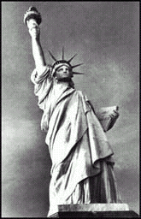
Shares & the Stock Market
Companies borrow money to pay for equipment or staff etc
Investors get a share of the profit the company makes
‘Shareholders’ can sell their shares on the stock market.
This is based in Wall Street, New York
Prices can change every day according to how well the company is doing.
Prices can also change no matter how the company is doing - Speculation

Slide 6
Speculation
American industry booms, price of shares move up
Investors sell their shares at higher prices and make huge profits
Get Rich, Quick!!
More people invest, pushing prices higher
People buy “on the margin”
Overextension of their credit

Slide 7
Speculation
20 million shareholders
by summer 1929
Car and Steel Production falls
Prices reach an all time high
Profits Fall
Experts start to worry
People start to Sell

Slide 8
Crash!
Sat 19th Oct
- 3.5 million shares sold.
- Prices fall
Sun 20th Oct
- “Stocks driven down as wave of selling engulfs market”

Slide 9
Crash!
Mon. 21st Oct
Over 6 million shares change hands.
Prices fall then rise in the afternoon.
There are still buyers on the market
Tue 22nd Oct
- Prices begin to rise

Slide 10
Crash!
Wed 23rd Oct
- 3 million shares sold in the last hour of trading
- Margin buyers told to find more cash
‘Black Thursday’ 24th Oct
- 13 million shares sold
- No buyers found
- Panic!!

Slide 11
Crash!
Fri 25th Oct
- Top bankers decide to support market
Banking firms buy millions of shares for more than they are worth
Sat 26th Oct
- President Hoover “The fundamental business of the country, is on a sound and secure basis”

Slide 12
Crash!
Mon. 28th Oct
- Massive selling
3 million shares sold in the last hour of trading
9 million sold in total
Banks stop supporting prices
Tuesday 29th Oct
16 million shares sold
No buyers found
Ticker tape machines break due to pressure, many are ruined before they can act

Slide 13
CRASH!!!
What’s happened to our shares???
C R A S H ! ! !

Slide 14
Re-Cap
Overproduction
Stocks of unsold goods
Demand falls
Profits Fall
People start to sell
shares
CRASH!!
Panic.

Slide 15
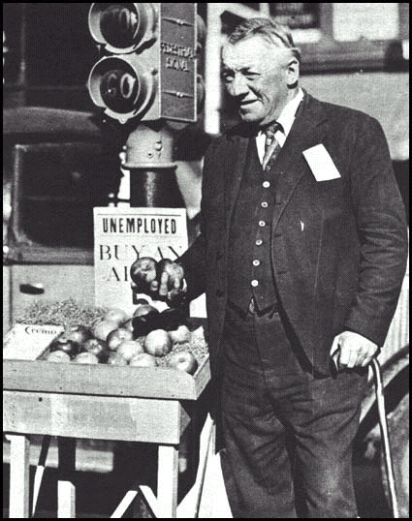
Consequences
Fred Bell was a wealthy businessman before the Wall Street Crash. He became one of the many unemployed men who tried to make a living by selling apples in the street

Slide 16
CONSEQUENCES

Slide 17
CONSEQUENCES
Thousands of small businesses go bust.
Banks closed.
People bought less : more of the above.
Economy spirals into recession
The Great Depression
By 1932, a new political direction wanted
FDR + his New Deal sweep into power…..

Slide 18
Your Task
Look at Consequences 1 2 3
For each consequence, produce a report about the consequences of Wall Street Crash
Walsh pp 213-215

Slide 19
Your Task
Consequence1
Look at the effects of the crash in the American cities

Slide 20
Your Task
Consequence 2
Look at the effects of the crash in the American countryside

Slide 21
Your Task
Consequence 3
Look at the international effects of the crash

